Slide 1


Find the Fireworks
Notes:
This is a structured play activity to work on /f/ sounds in isolation via teletherapy, incorporating choices, word exposures, and movement breaks.
Developed by Youran Lin, BA, MA, MScSLP/PhD student at the University of Alberta.

Slide 2
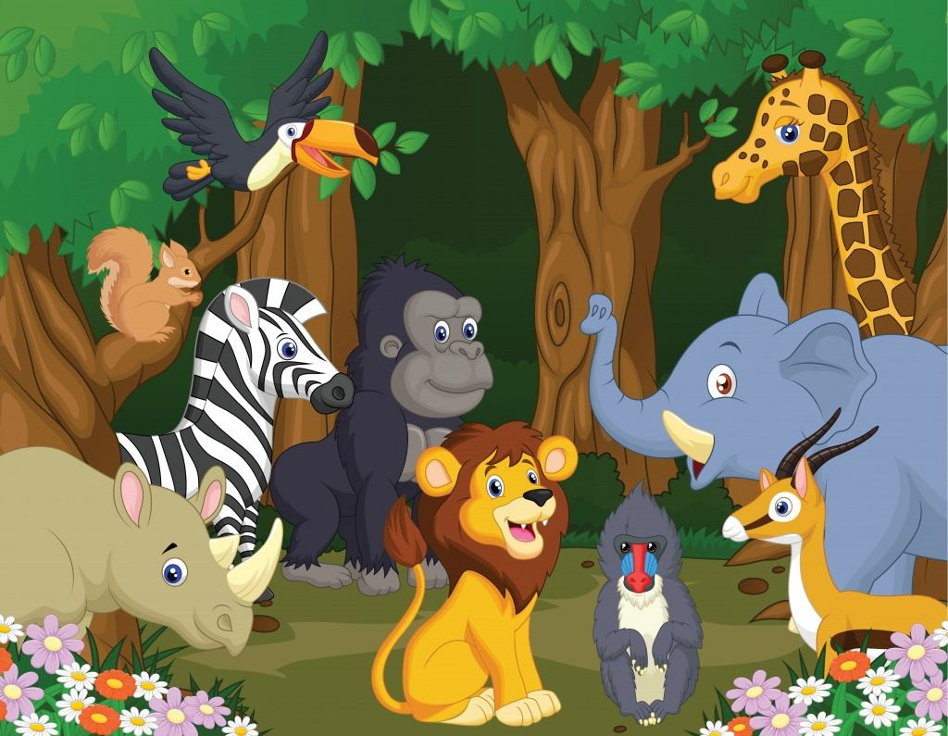

Notes:
Funny Bunny lives in a jungle with her friends.

Slide 3
Notes:
She wants to surprise her friends with beautiful fireworks.

Slide 4






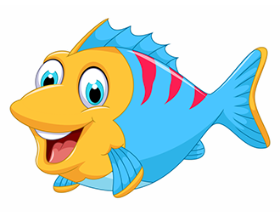




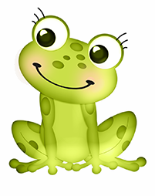
Notes:
Funny Bunny sets out to look for fireworks. She sees four treasure boxes.
The treasure boxes are so far away. Funny Bunny has to hop over there.
[use the next 2 slides to demonstrate how to “hop” and “breathe”]
Mommy please use your big steps to measure where to start (2 steps, or let her choose).
Hop-and-breathe, until you can high-five with Mommy (or get close enough to the computer).
Let’s open a treasure box! Which one do you want to check?

Slide 5
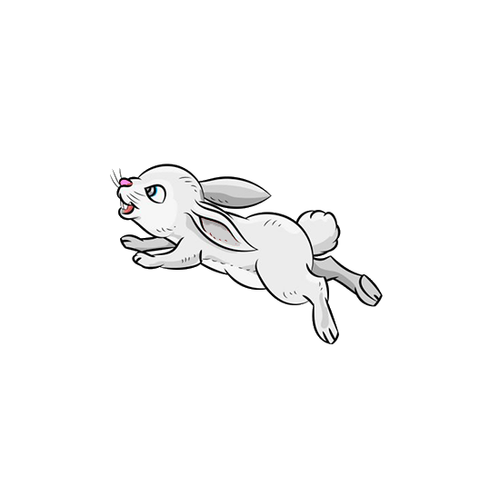
× 1
Notes:
From your starting point, hop!

Slide 6


× 5
Notes:
Each time you hop, you need to take a break and do the funny bunny breathing /f/.

Slide 7
Notes:
Funny Bunny goes back to the jungle with her new friends and her surprise!

Slide 8
Notes:
Slowly, she opens the treasure box. Everyone holds their breath and widens their eyes. Three, two, one...

Slide 9

Notes:
There come the most beautiful fireworks in the world!
(The .gif file requires the PowerPoint to be presented. But if you upload it as Google Slides, it’ll move without being presented.)

Slide 10

The End

